Slide 1
OOM Mini Project-I 9-Box Puzzle Game Software
Group B11
Prachi Kumari iit2022206
Ananya garg iit2022208
Sanjana Prajapati iit2022214

Slide 2
Abstract of the Project
A Game Software has to be prepared with target users in mind, A nine box puzzle game consists of nine boxes that are labeled form one to eight. The ninth box is without a level. These level boxes are not arranged in an order. A player needs to arrange the labeled boxes serially. The puzzle game count the number of attempts made by the player to win the game. A player with the minimum number of attempt is the winner. The puzzle game also accepts the name of the player and keeps track of the Players performance. Make necessary assumptions as and when required and state them clearly.

Slide 3
Our Approach
GUI Initialization:
Frame and Panels Setup:
Extends Frame class to create the main window for the game.
Sets up panels (p1 and p2) to organize different parts of the GUI (buttons, labels, game grid).
Buttons, Labels, and Actions:
Initializes buttons (re, re1) for starting a new game and displaying the leaderboard.
Sets up labels (l1, l2, l3, l4, l5) for displaying messages, moves, and username.
Defines action listeners for buttons to handle user interactions.
Game Logic:
Game Mechanics:
Implements the puzzle logic within the Game class.
Handles the movement of tiles within the 3x3 grid based on user clicks.
Randomly generates a solvable puzzle layout using the rand() method.
Checking Win Condition:
Checks for the win condition after every move to determine if the tiles are back in their original positions (1 through 8).
If the win condition is met, displays a message indicating victory and updates the leaderboard with the player's name and score.

Slide 4
Leaderboard and File Handling:
Leaderboard Display:
Utilizes a JTable (newPane() method) to display a leaderboard showing top scores and usernames.
Reads data from a file (database.txt) to populate the leaderboard.
File Operations:
Manages file read and write operations to store and retrieve player scores and names.
Writes the player's score and name to the file when a game is won.
Supporting Classes:
playerData and Leaderboard Classes:
playerData class represents a data structure to hold player names and scores.
Leaderboard class implements a custom comparator for sorting playerData objects based on score and name.
Additional Features:
Handling Window Events:
Overrides WindowAdapter to handle the window closing event with a confirmation dialog.
Overall Approach:
The code follows an object-oriented approach, utilizing Swing components for the GUI and implementing game logic within the Game class. It manages user interactions, tracks moves, checks for win conditions, handles file operations for leaderboard data, and provides a graphical representation of a 9-box puzzle game. The implementation includes error handling and supports features like leaderboard display and storage of player scores

Slide 5
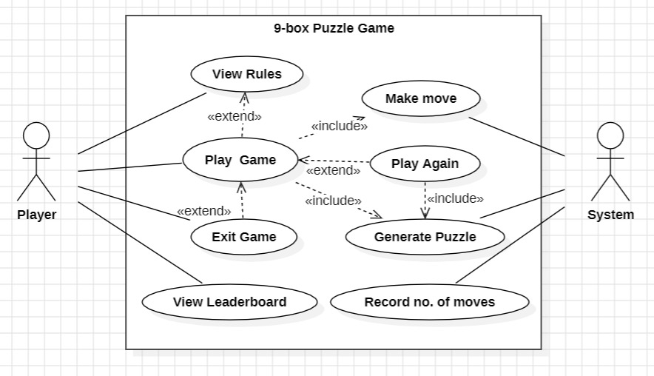
Use Case Diagram

Slide 6
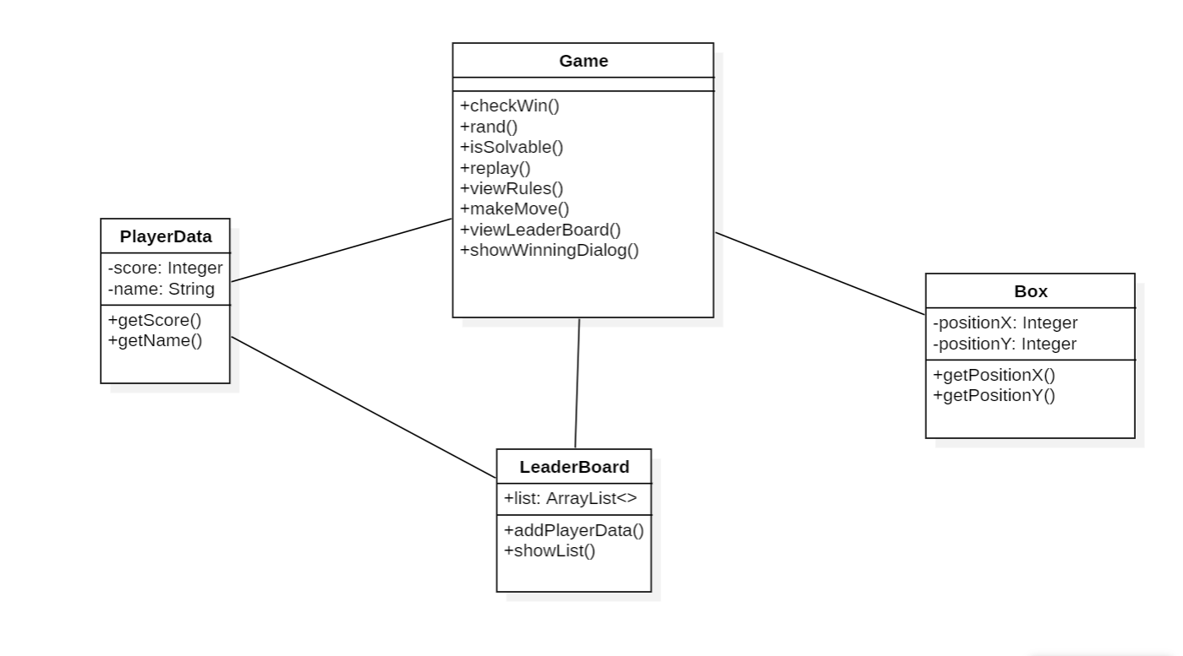
Class Diagram

Slide 7
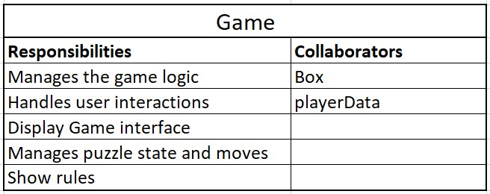
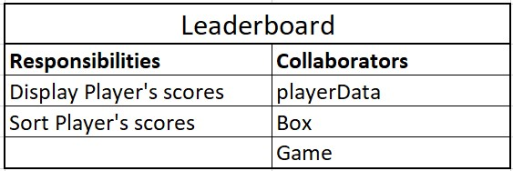
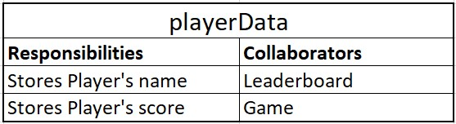
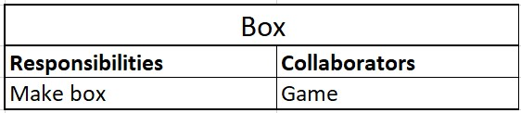
CRC Diagram

Slide 8
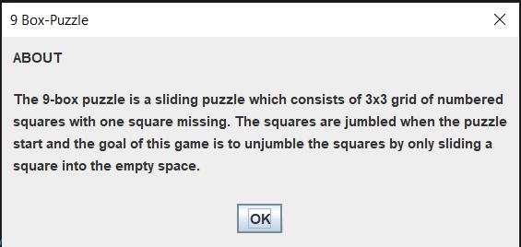
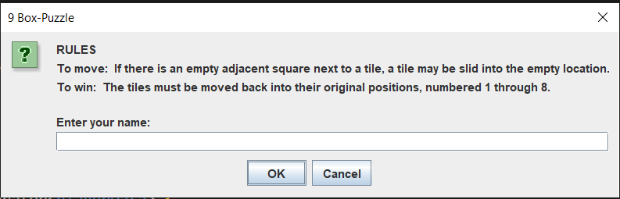

Slide 9
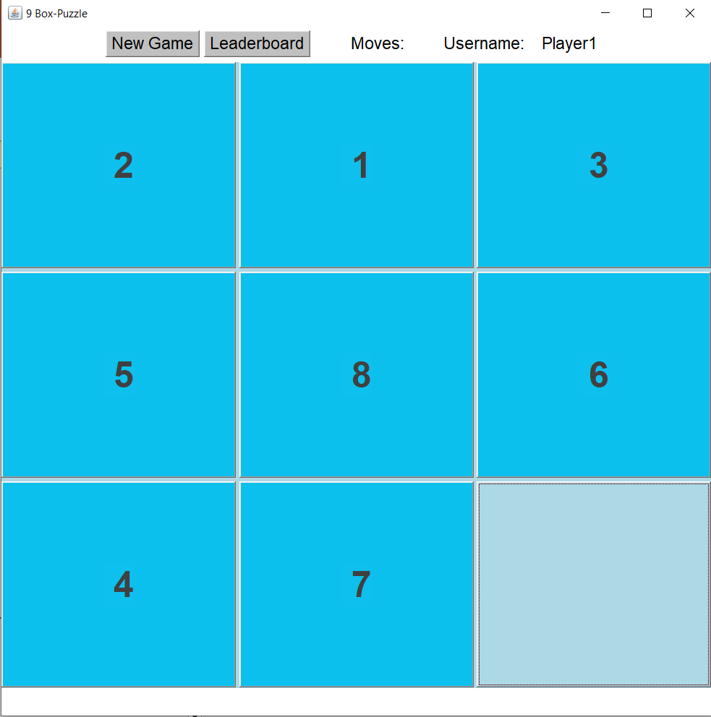
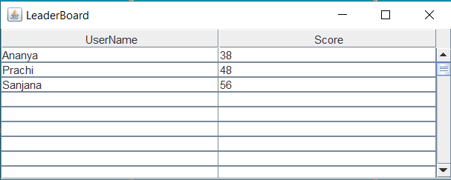

Slide 10
THANK YOU!

